Slide 1
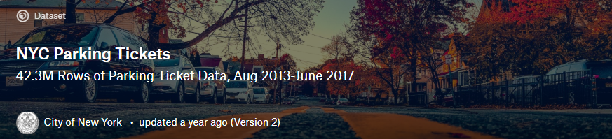

Term Paper Group 4
GROUP MEMBERS:
ZHICHENG YU
LOUIS TAN
NEVIN YILMAZ
GitHub link:
https://github.com/nyilmaz1/NYC_parking-Hive.git
Dataset Download page:
https://www.kaggle.com/new-york-city/nyc-parking-tickets

Slide 2
Dataset Overview
Context
The NYC Department of Finance collects data on every parking ticket issued (~10M per year!). This data is publicly available to aid in ticket resolution and to guide policymakers in NYC
Data used:
NYC Parking Violation Data (Between2012.7 and 2014.7) Size: 1.7 GB
Total table columns: 51
Total table rows: 9 millions UP

Slide 3
Inspiration
What days were the tickets issued most?
Is there a relationship between having a parking ticket and say, having a big car, like a truck or a small car?
Do people who have newer cars care more than those who have older cars?
Do people who have luxurious cars are more careful on how and where they park their cars?
What are the most common words used?
What are the most common violation types?
And more…

Slide 4
Contents
Summons Number: Nu
Plate ID: Plain Text
Registration State: Plain Text
Plate Type: Plain Text
Issue Date: Date & Time
Violation Code: Number
Vehicle Body Type: Plain Text
Vehicle Make: Plain Text
Issuing Agency: Plain Text
Street Code1: Number
Street Code2: Number
Street Code3: Number
Vehicle Expiration Date: Number
Violation Location: Plain Text
Violation Precinct: Number
Issuer Precinct: Number
Issuer Code: Number
Issuer Command: Plain Text
Issuer Squad: Plain Text
Violation Time: Plain Text
Time First Observed: Plain Text
Violation County: Plain Text
Violation In Front Of Or Opposite: Plain Text
House Number: Plain Text
Street Name: Plain Text
Intersecting Street: Plain Text
Date First Observed: Number
Law Section: Number
Sub Division: Plain Text
Violation Legal Code: Plain Text
Days Parking In Effect: Plain Text
From Hours In Effect: Plain Text
To Hours In Effect: Plain Text
Vehicle Color: Plain Text
Unregistered Vehicle: Plain Text
Vehicle Year: Number
Meter Number: Plain Text
Feet From Curb: Number
Violation Post Code: Plain Text
Violation Description: Plain Text
No Standing or Stopping Violation: Plain Text
Hydrant Violation: Plain Text
Double Parking Violation: Plain Text

Slide 5
Data Type sample
Summons_Number | int
Plate_ID | string
Registration_State | string
Plate_Type | string
Issue_Date | string
Violation_Code | int
Vehicle_Body_Type | string
Vehicle_Make | string
Issuing_Agency | char(255)
Summons Number | 1283294138
Plate ID | GBB9093
Registration State | NY
Plate Type | PAS
Issue Date | 8/4/2013
Violation Code | 46
Vehicle Body Type | SUBN
Vehicle Make | AUDI
Issuing Agency | P

Slide 6
ENVIRONMENT
16GB RAM
Node: 3
HDFS Version: 2.7.3
Hive Version 1.2.1000
Data used in following slides: NYC Parking Violation Data (Between 2012.7 and 2014.7) Size: 1.7 GB
CPU: V4 2.2GHZ

Slide 7
WORKFLOW 1
Download
Data from
kaggle.com
Upload csv file
into HDFS
Using Ambari
Run scripts
using HiveVIew2
On Ambari
Data
Visualization
using EXCEL and Tableau
Convert table file to csv
Generate query data as table

Slide 8
WORKFLOW 2
Download
Data from
kaggle.com
Upload csv file
into HDFS USING SFTP
Use Oracle Server to run HIVEQL
Data
Visualization
using EXCEL
Export table data as csv file
Create tables to store query data

Slide 9

WORKFLOW 3
Download Data from kaggle.com
Data Prep (clean data, convert date format)
Upload csv file into HDFS Using Ambari
Create table using HiveQL
Data Visualization using Tableau
Convert text file to csv
Analyze data using HiveQL, generate text file

Slide 10
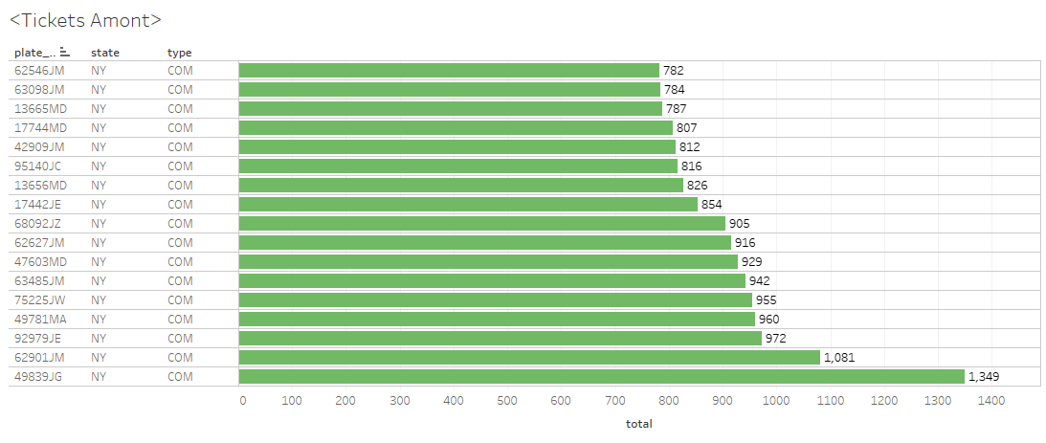
Top 19 Violation plate numbers

Slide 11
Model Year | Count
2004 | 359978
2010 | 380282
2005 | 397221
2008 | 405115
2006 | 417367
2007 | 482122
2011 | 511095
2012 | 647398
2013 | 784399
Top 9 violation car model years

Slide 12
violation_code | total
38 | 1243474
21 | 1239580
14 | 851688
37 | 738567
Top 4 violation codes
Meter Parking $65
Street Cleaning $65
No Parking $95
Meter Parking $65

Slide 13
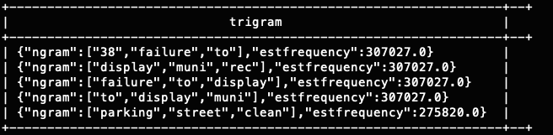
Ngram Five most common trigrams

Slide 14
Top 4 Violation Model Types
vehicle_body_type | total
SUBN | 2797673
4DSD | 2513564
VAN | 1384386
DELV | 730517

Slide 15
vehicle_make | total
FORD | 1248618
TOYOT | 878781
HONDA | 810453
CHEVR | 743552
Top 4 Violation Brands

Slide 16
violation_time | total
0836A | 27495
1136A | 23681
0806A | 23229
0936A | 22780
1140A | 22323
Top 5 Violation Times

Slide 17
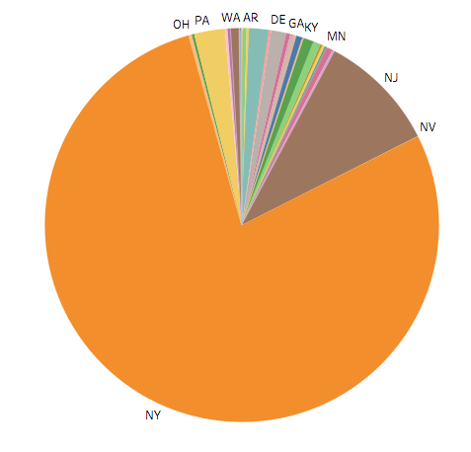
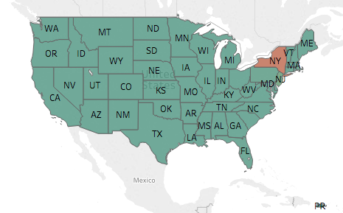
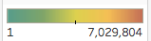
Tickets sorted by cars registered states (1)
Most tickets are given to cars registered in NY,NJ
Unfortunately, cars registered in other states than NJ are too few to be distinguished on the geo-map

Slide 18
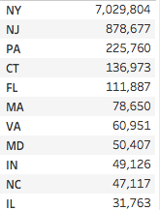
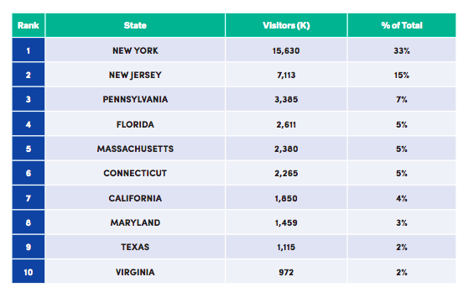
Tickets sorted by cars registered states (2)
Parking Violation Registered State 70% matching visitor data!
What does that mean?
Travelers are more easily to get ticket than locals? NO; Cannot prove that, no car data in NYC
A good conclusion? People do change their plate/registration after moving to another state.,

Slide 19
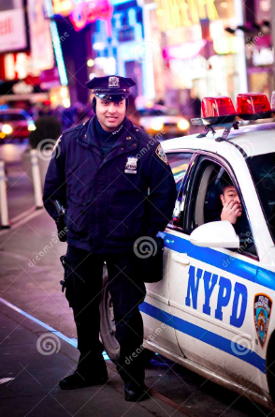
TOUGHEST OFFICER
From ‘issuer_code’ we queried top 5 officers that signing most parking tickets. Pay extra attention to those who wear these ID numbers if you want to escape from a parking ticket.
ID, Tickets given between 2012.7 and 2014.7
355542,16770
357092,13631
345534,13586
352979,12853
355598,12245

Slide 20
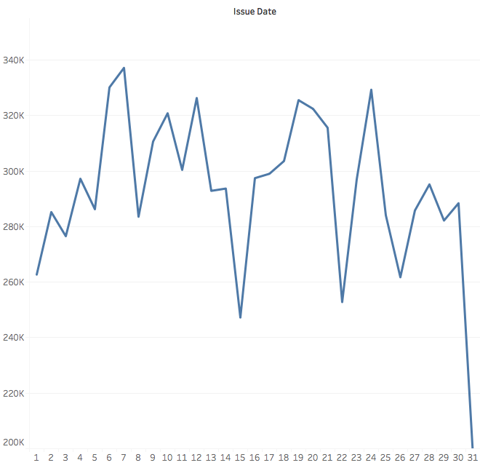
ESCAPE FROM PARKING TICKETS
When should I be more careful based on the day of month if I’m driving in NYC?
The answer is the 6th,7th, 17-20th, 23th 24th;
Rumor of Police KPI

Slide 21
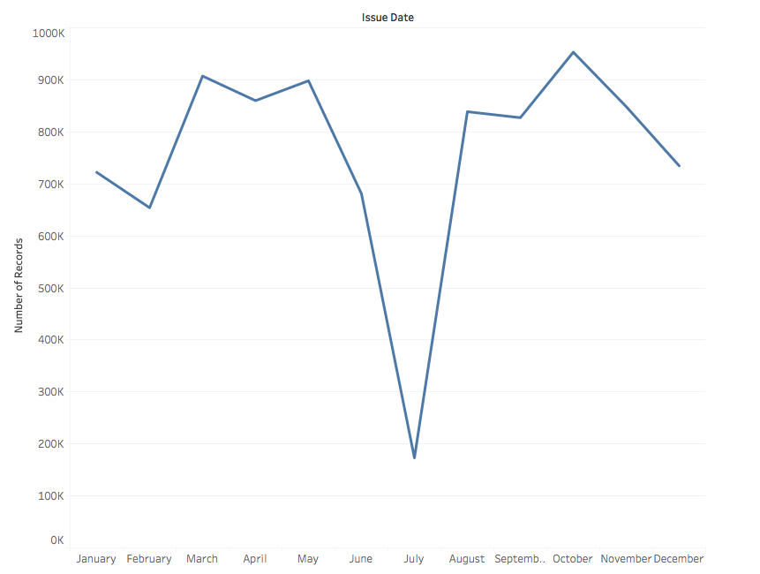
summer is the parking season(1)
Fewer police officers in summer?
Or because of the weather, there are fewer cars

Slide 22
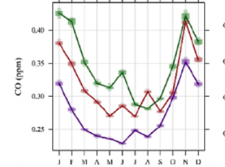
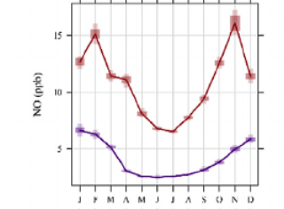
summer is the parking season(2)
To prove that, I researched for CO and NO (which are the main vehicle emission pollution chemicals) data of NYC, which provide strong evidence that there are more cars in winter than summer

Slide 23
Acknowledgments
PM2.5 and gaseous pollutants in New York State during 2005–2016: Spatial variability, temporal trends, and economic influences( https://www.sciencedirect.com/science/article/pii/S1352231018301997)
New York City Travel and Tourism Trend Report 2017(https://www.nycgo.com/assets/files/pdf/new_york_city_travel_and_tourism_trend_report_2017.pdf)

Slide 24
Questions?

